Slide 1

PIERIAN CLOUD

Slide 3

Google Cloud Associate Cloud Engineer
Managed Services
Tour

Slide 4
Google Cloud Associate Cloud Engineer
Google Cloud offers a wide range of managed services.
In this section we’ll take a brief look at some of their most popular offerings.
Many of these services fall under the Big Data or Machine Learning segments of GCP.

Slide 5
Google Cloud Associate Cloud Engineer
Section Overview:
BigQuery
Dataflow
Dataprep
Dataproc
Cloud Functions
Pub/Sub

Slide 6
Google Cloud Associate Cloud Engineer
Keep in mind that at the Associate Cloud Engineer level, Google doesn’t expect you to be an expert in every single one of these services, instead try to understand their use cases and key features.

Slide 7
Google Cloud Associate Cloud Engineer
Different Professional Level certifications focus on these managed services, for example the GCP Professional Data Engineer focuses on many of the Big Data and ML services (Dataflow, Dataprep, Dataproc, etc…).

Slide 8
Google Cloud Associate Cloud Engineer
Let’s get started!

Slide 9
Google Cloud Associate Cloud Engineer
BigQuery

Slide 10
Google Cloud Associate Cloud Engineer
BigQuery is one of GCP’s flagship products, with lots of additional development and tools being added often.
It should also be noted that its often an outside user’s first experience with GCP, since it can be used by analysts.

Slide 11
Google Cloud Associate Cloud Engineer
BigQuery is a fully managed enterprise data warehouse that helps you manage and analyze your data with built-in features like machine learning, geospatial analysis, and business intelligence.

Slide 12
Google Cloud Associate Cloud Engineer
BigQuery's scalable, distributed analysis engine lets you query terabytes in seconds and petabytes in minutes.
BigQuery maximizes flexibility by separating the compute engine that analyzes your data from your storage choices.

Slide 13
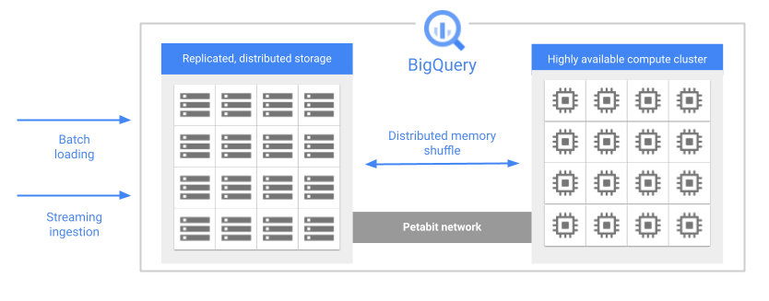
Google Cloud Associate Cloud Engineer
Separation of storage and compute allows BigQuery to scale both storage and compute independently, based on demand.

Slide 14
Google Cloud Associate Cloud Engineer
You can store and analyze your data within BigQuery or use BigQuery to assess your data where it lives.
Federated queries let you read data from external sources while streaming supports continuous data updates.

Slide 15
Google Cloud Associate Cloud Engineer
BigQuery also has analytic tools such as BigQuery ML and BI Engine.
BigQuery ML let’s you build ML models inside of BigQuery.
BI Engine is a fast, in-memory analysis service.

Slide 16
Google Cloud Associate Cloud Engineer
BigQuery is often associated with SQL as the main interface, but it actually supports client libraries with familiar programming languages including Python, Java, JavaScript, and Go.

Slide 17
Google Cloud Associate Cloud Engineer
BigQuery has three main pillars:
Storage
Analytics
Administration
Let’s explore each of these features in more detail…

Slide 18
Google Cloud Associate Cloud Engineer
BigQuery Storage:
Storage is fully managed by BigQuery, meaning you don’t worry about provisioning servers or hardware configuration.
Sizing is automatically done and you only pay for what you use.

Slide 19
Google Cloud Associate Cloud Engineer
BigQuery Storage:
A unique aspect of BigQuery is columnar datastore architecture.
Let’s explore what this means…

Slide 20
Google Cloud Associate Cloud Engineer
BigQuery Storage:
Traditional RDBMS Storage
Row Record
Oriented

Slide 21
Google Cloud Associate Cloud Engineer
BigQuery Storage:
Traditional RDBMS Storage
Row Record
Oriented

Slide 22
Google Cloud Associate Cloud Engineer
BigQuery Storage:
BigQuery Columnar Storage
Co-located by Column

Slide 23
Google Cloud Associate Cloud Engineer
BigQuery Storage:
BigQuery Columnar Storage
Co-located by Column

Slide 24
Google Cloud Associate Cloud Engineer
BigQuery Storage:
This architecture is based on a proprietary file format called Capacitor.
Capacitor can reshuffle data to achieve compact recording.

Slide 25
Google Cloud Associate Cloud Engineer
BigQuery Storage:
Q1 | 0
Q1 | 0
Q1 | 2
Q1 | 1
Q2 | 1
Q2 | 1

Slide 26
Google Cloud Associate Cloud Engineer
BigQuery Storage:
Q1 | 0
Q1 | 0
Q1 | 2
Q1 | 1
Q2 | 1
Q2 | 1
Q1 : 4
Q2 : 2

Slide 27
Google Cloud Associate Cloud Engineer
BigQuery Storage:
Q1 | 0
Q1 | 0
Q1 | 2
Q1 | 1
Q2 | 1
Q2 | 1
Q1 : 4
Q2 : 2
0:2
2:1
1:3

Slide 28
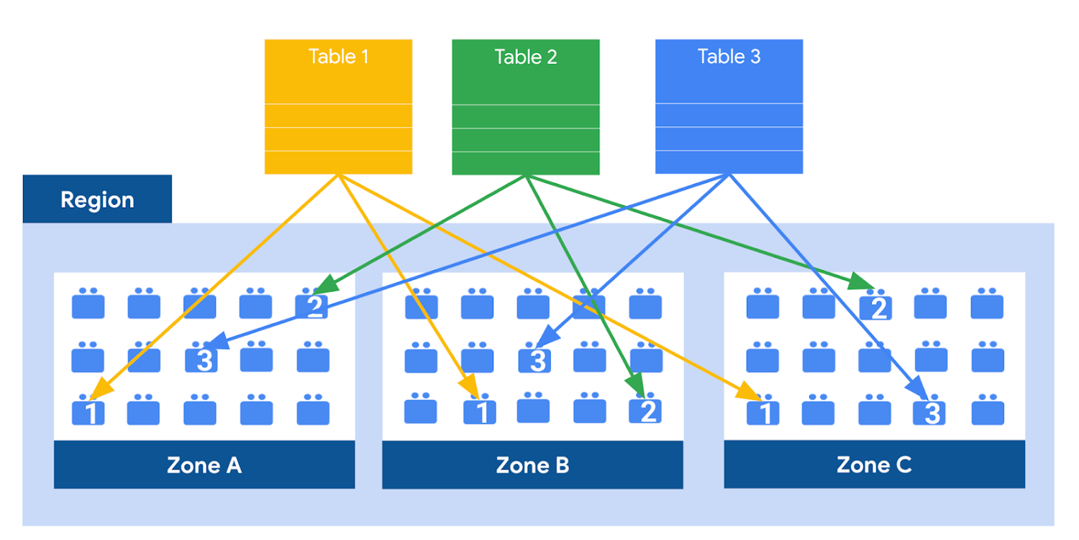
Google Cloud Associate Cloud Engineer
BigQuery Storage:
BigQuery also takes steps to ensure durability through replication on Colossus.

Slide 29
Google Cloud Associate Cloud Engineer
BigQuery Analytics:
Bigquery is designed to have highly efficient query processing.
Let’s take a quick look at the steps it takes to achieve that for a query.

Slide 30
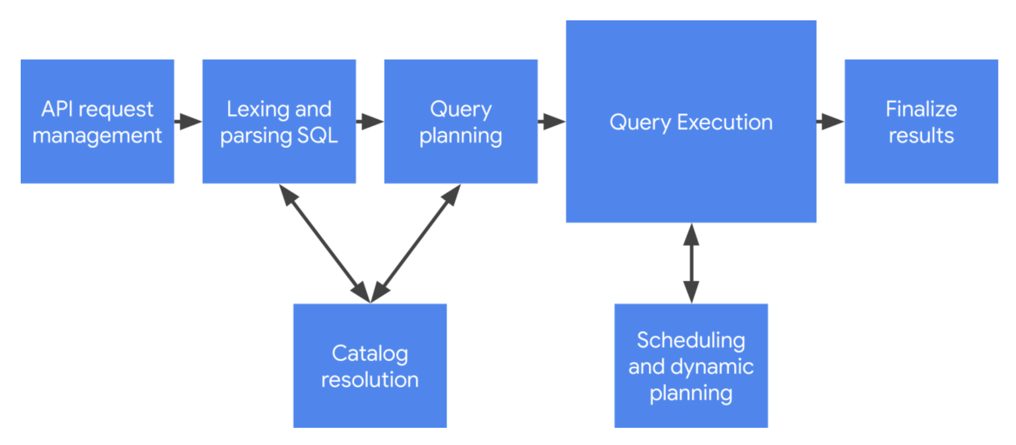
Google Cloud Associate Cloud Engineer
BigQuery Analytics:

Slide 31
Google Cloud Associate Cloud Engineer
BigQuery Administration:
BigQuery provides several interfaces you can use for administration tasks:
Cloud Console
SQL Statements
bq commands (command line tool)

Slide 32
Google Cloud Associate Cloud Engineer
BigQuery also has a sandbox mode allowing you to explore its capabilities without worrying about billing.
We’ll check it out in the next demo lecture!

Slide 33
Google Cloud Associate Cloud Engineer
Review:
We learned the basics of BigQuery.

Slide 34
Google Cloud Associate Cloud Engineer
Up Next:
Let’s get a demo to explore Big Query!

Slide 35
Google Cloud Associate Cloud Engineer
DEMO:
BigQuery

Slide 36
Google Cloud Associate Cloud Engineer
For this demo, we’ll use the Sandbox version of BigQuery.
BigQuery Sandbox is subject some limits.
Let’s quickly go over them before we continue with the demo.

Slide 37
Google Cloud Associate Cloud Engineer
Sandbox limitations:
All BigQuery quotas and limits apply.
You are granted the same free usage limits as BigQuery's free tier: 10 GB of active storage and 1 TB of processed query data per month.

Slide 38
Google Cloud Associate Cloud Engineer
Sandbox limitations:
You can create up to 1 GB of BigQuery BI Engine capacity.
All datasets have the default table expiration time and the default partition expiration set to 60 days.

Slide 39
Google Cloud Associate Cloud Engineer
Sandbox limitations:
No support for:
Streaming data
Data manipulation language (DML) statements
BigQuery Data Transfer Service

Slide 40
Google Cloud Associate Cloud Engineer
Dataflow

Slide 41
Google Cloud Associate Cloud Engineer
Dataflow is a managed service for executing a wide variety of data processing patterns.
Often data is being created in real-time from devices and sources and users need a service to manage this streaming data flow.

Slide 42
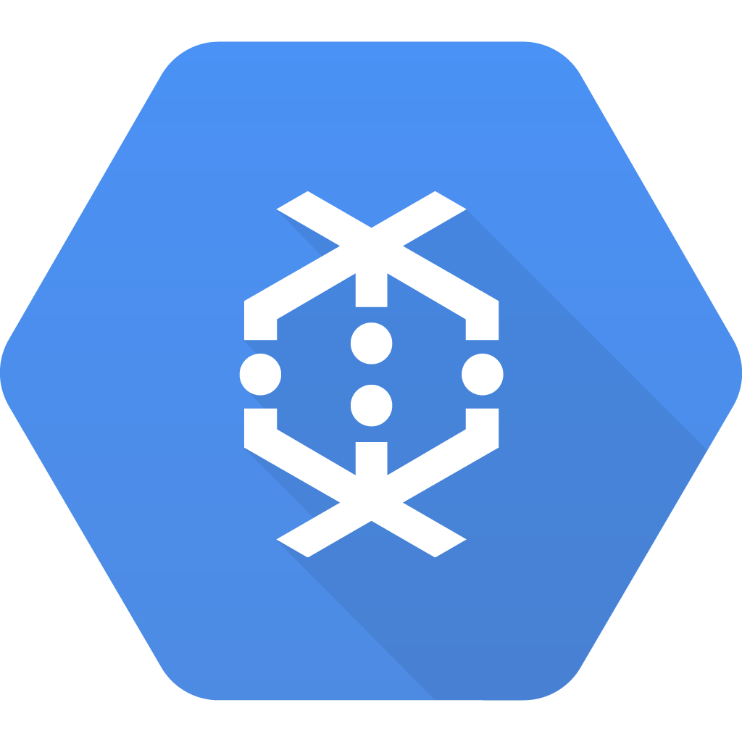
Google Cloud Associate Cloud Engineer
Dataflow is designed for stream and batch data with automated provisioning and management of processing resources.

Slide 43
Google Cloud Associate Cloud Engineer
It does this through the use of pipelines, which encapsulate the entire series of computations involved in reading input data, transforming that data, and writing output data.

Slide 44
Google Cloud Associate Cloud Engineer
Google has open-sourced the programming mode for defining and executing these pipelines through Apache Beam.

Slide 45
Google Cloud Associate Cloud Engineer
Dataflow sits in the middle of a data transformation workflow, focusing on processing stream and batch data for analysis.

Slide 46
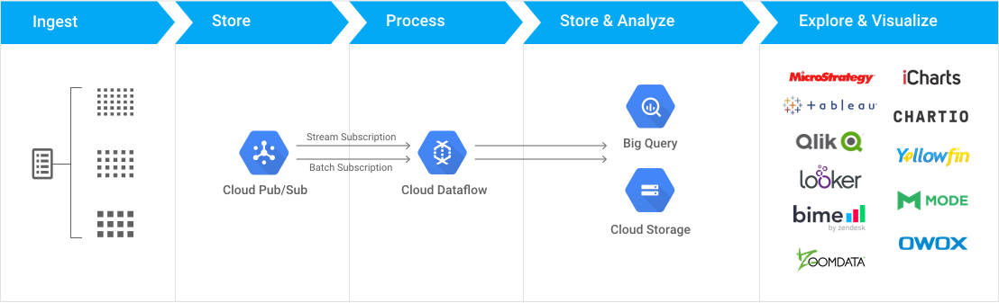
Google Cloud Associate Cloud Engineer

Slide 47
Google Cloud Associate Cloud Engineer
Review:
We learned about Dataflow which can be used for batch or stream data.

Slide 48
Google Cloud Associate Cloud Engineer
Up Next:
We’ll explore Dataprep!

Slide 49
Google Cloud Associate Cloud Engineer
Dataprep

Slide 50
Google Cloud Associate Cloud Engineer
Dataprep is a service that lives on GCP but is actually created by another company called Trifacta (part of Alteryx).
Dataprep enables analysts, data specialists, and other domain experts to quickly cleanse and transform datasets of varying sizes for use throughout the enterprise.

Slide 51
Google Cloud Associate Cloud Engineer
Dataprep key capabilities:
Import from flat file, databases, or distributed storage systems.
Locate and remove or modify missing or mismatched data .
Unnest complex data structures.

Slide 52
Google Cloud Associate Cloud Engineer
Dataprep key capabilities:
Identify statistical outliers in your data for review and management.
Perform lookups from one dataset into another reference dataset.

Slide 53
Google Cloud Associate Cloud Engineer
Dataprep key capabilities:
Aggregate columnar data using a variety of aggregation functions.
Normalize column values for more consistent usage and statistical modeling.

Slide 54
Google Cloud Associate Cloud Engineer
Dataprep key capabilities:
Merge datasets with joins.
Append one dataset to another through union operations.

Slide 55
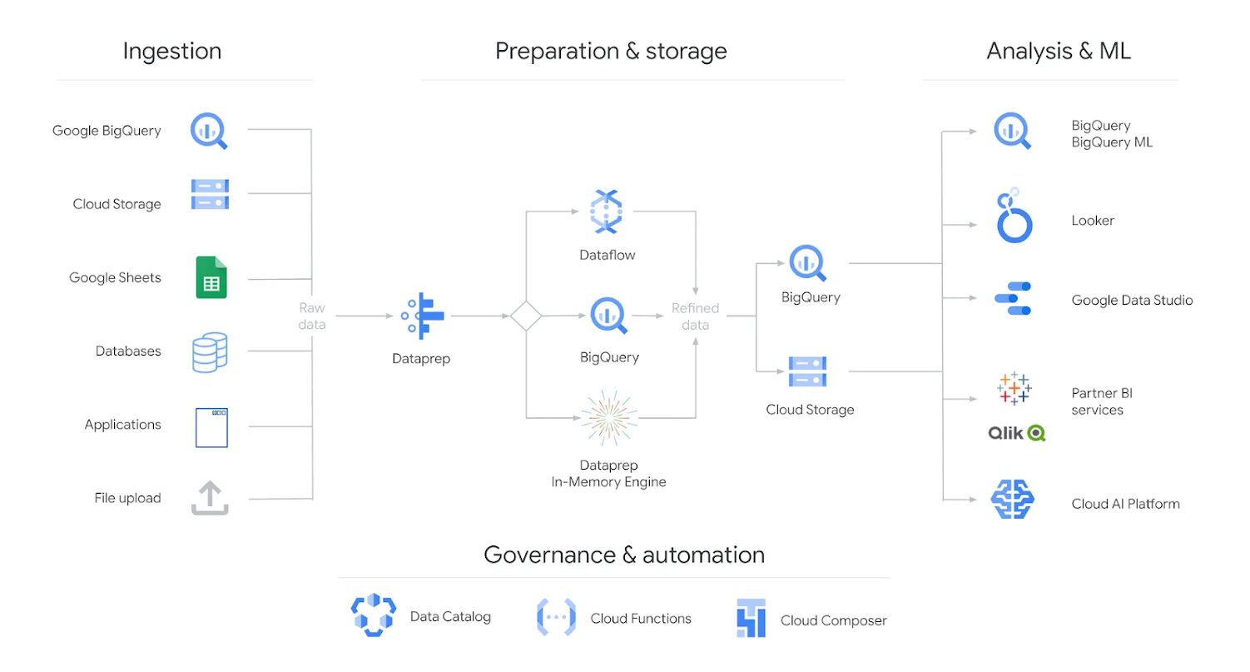
Google Cloud Associate Cloud Engineer

Slide 56
Google Cloud Associate Cloud Engineer
Review:
We learned about Dataprep.

Slide 57
Google Cloud Associate Cloud Engineer
Up Next:
We’ll explore Dataproc!

Slide 58
Google Cloud Associate Cloud Engineer
Dataproc

Slide 59
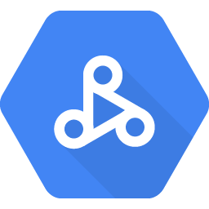
Google Cloud Associate Cloud Engineer
Dataproc is a fully managed and highly scalable service for running Apache Spark, Apache Flink, Hadoop, Presto, and 30+ open source tools and frameworks.

Slide 60
Google Cloud Associate Cloud Engineer
Dataproc allows for serverless deployment, logging, and monitoring which let’s users such as data scientists focus on their analytics rather than worrying about infrastructure.

Slide 61
Google Cloud Associate Cloud Engineer
Dataproc nodes can be deployed and spun up in less than 90 seconds and can be easily customized and resized with the optimal resources required for individual jobs.

Slide 62
Google Cloud Associate Cloud Engineer
Dataproc Hub can enable data scientists and engineers to build and train models 5X faster through integration with Vertex AI Workbench and common interfaces such as Jupyter Notebook.

Slide 63
Google Cloud Associate Cloud Engineer
The Dataproc Jobs API makes it easy to incorporate big data processing into custom applications, while Dataproc Metastore eliminates the need to run your own Hive metastore or catalog service.

Slide 64
Google Cloud Associate Cloud Engineer
You’ve probably noticed that Dataproc seems to live at a similar point in the data workflow as Dataflow.
So when should you use Dataproc instead of Dataflow?

Slide 65
Google Cloud Associate Cloud Engineer
Dataproc vs. Dataflow:
Use Dataproc when you have dependencies on Hadoop or Spark.
You should also check for existing integrations, such as Presto.

Slide 66
Google Cloud Associate Cloud Engineer
Dataproc vs. Dataflow:
If you don’t have dependencies on those cluster based libraries and also need automatic provisioning of clusters, then choose Dataflow.

Slide 67
Google Cloud Associate Cloud Engineer
Review:
We learned about Dataproc.

Slide 68
Google Cloud Associate Cloud Engineer
Up Next:
Let’s get an understanding of Dataproc inside GCP by going through a simple demo!

Slide 69
Google Cloud Associate Cloud Engineer
DEMO:
Dataproc

Slide 70
Google Cloud Associate Cloud Engineer
In this demo we’ll use Dataproc for the following:
Creating a Dataproc Cluster
View the created VM Instances
Update worker nodes
Submit an example job

Slide 71
Google Cloud Associate Cloud Engineer
Cloud Functions

Slide 72
Google Cloud Associate Cloud Engineer
Cloud Functions allow you to run your code in the cloud with no servers or containers to manage.
Cloud Functions is a scalable, pay-as-you-go functions as a service (FaaS) product to help you build and connect event driven services with simple, single purpose code.

Slide 73
Google Cloud Associate Cloud Engineer
You can think of Cloud Functions as a very high level abstraction suited for developers.
Developers just write code and let Google Cloud handle the operational infrastructure, allowing them to develop faster by writing and running small code snippets that respond to events.

Slide 74
Google Cloud Associate Cloud Engineer
You are only billed for your function’s execution time, metered to the nearest 100 milliseconds.
You pay nothing when your function is idle.
Cloud Functions automatically spins up and backs down in response to events.

Slide 75
Google Cloud Associate Cloud Engineer
You are only billed for your function’s execution time, metered to the nearest 100 milliseconds.
You pay nothing when your function is idle.
Cloud Functions automatically spins up and backs down in response to events.

Slide 76
Google Cloud Associate Cloud Engineer
It supports a wide variety of languages, including:
Node.js
Python
Go
Java
.NET
Ruby
PHP

Slide 77
Google Cloud Associate Cloud Engineer
Using Cloud Functions is really as simply as opening up the Cloud Functions panel, setting a Trigger and Authentication and then uploading your Source Code.
You can even use the inline editor inside Google Cloud Console to write your code without leaving GCP.

Slide 78
Google Cloud Associate Cloud Engineer
The online documentation provides Quickstart examples and guides for all the languages:
cloud.google.com/functions/docs/

Slide 79
Google Cloud Associate Cloud Engineer
Review:
We learned about Cloud Functions.

Slide 80
Google Cloud Associate Cloud Engineer
Up Next:
We’ll explore Pub/Sub on GCP.

Slide 81
Google Cloud Associate Cloud Engineer
Pub/Sub

Slide 82
Google Cloud Associate Cloud Engineer
Pub/Sub allows services to communicate asynchronously, with latencies on the order of 100 milliseconds.

Slide 83
Google Cloud Associate Cloud Engineer
Pub/Sub is used for streaming analytics and data integration pipelines to ingest and distribute data.
It is equally effective as a messaging- oriented middleware for service integration or as a queue to parallelize tasks.

Slide 84
Google Cloud Associate Cloud Engineer
Pub/Sub enables you to create systems of event producers and consumers, called publishers and subscribers.
Publishers communicate with subscribers asynchronously by broadcasting events.

Slide 85
Google Cloud Associate Cloud Engineer
Publishers send events to the Pub/Sub service, without regard to how or when these events are to be processed.
Pub/Sub then delivers events to all services that need to react to them.

Slide 86
Google Cloud Associate Cloud Engineer
Pub/Sub Use Cases:
Ingestion user interaction and server events.
To make use of user interaction events from apps, you may forward them to Pub/Sub and then use a stream processing tool (such as Dataflow) which delivers them to BigQuery.

Slide 87
Google Cloud Associate Cloud Engineer
Pub/Sub Use Cases:
Real-time event distribution
Events, raw or processed, may be made available to multiple applications across your team and organization for real time processing.

Slide 88
Google Cloud Associate Cloud Engineer
Pub/Sub Use Cases:
Replicating data among databases
Pub/Sub is commonly used to distribute change events from databases.

Slide 89
Google Cloud Associate Cloud Engineer
Pub/Sub Use Cases:
Enterprise event bus
You can create an enterprise-wide real-time data sharing bus, distributing business events, database updates, and analytics events across your organization.

Slide 90
Google Cloud Associate Cloud Engineer
Pub/Sub Use Cases:
Refreshing distributed caches
For example, an application can publish invalidation events to update the IDs of objects that have changed.

Slide 91
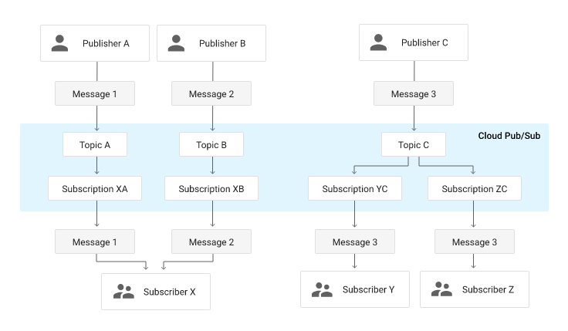
Google Cloud Associate Cloud Engineer

Slide 92
Google Cloud Associate Cloud Engineer
Review:
We learned about Google Cloud Pub/Sub.

